Slide 1
Chapter 3 Decompositions of Graphs
School of Science, Yanshan University
Wang Gang

Slide 2
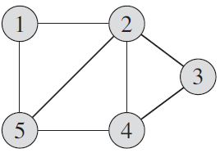
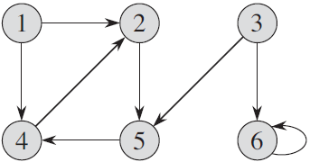
Graphs
Graph: G=(V, E)
Vertex set: V=V(G)
Edge set: E=E(G)

Slide 3
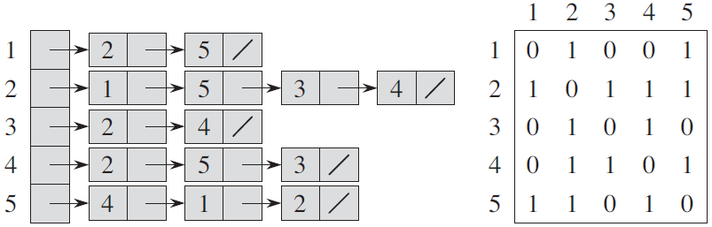
Graphs
Graph: G=(V, E)
Vertex set: V=V(G)
Edge set: E=E(G)
Adjacency List Adjacency Matrix
Space: O(|V|+|E|) O(|V|²)

Slide 4
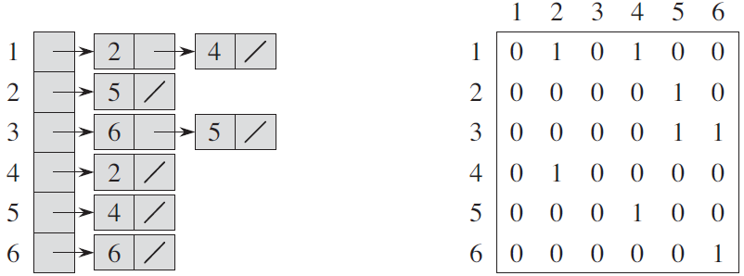
Graphs
Graph: G=(V, E)
Vertex set: V=V(G)
Edge set: E=E(G)
Adjacency List Adjacency Matrix
Space: O(|V|+|E|) O(|V|²)

Slide 5
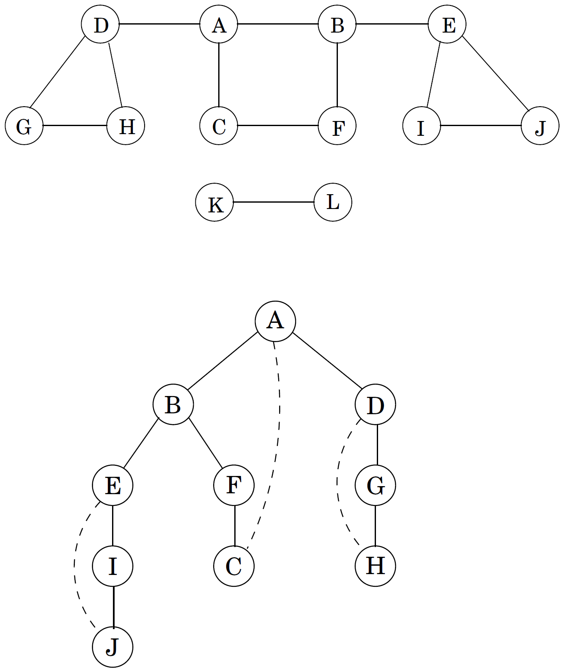
Depth-First Search in undirected graphs
Given a graph, in the form of an adjacency list, visit all the vertex.
procedure dfs(G)
for all v∈V
visited(v) = false
for all v∈V
if not visited(v)
explore(v)
procedure explore(G, v)
Input: G=(V, E); v∈V
Output: visited(u) = true for all nodes
u reachable from v
visited(v) = true
for each edge (v, u)∈E
if not visited(u)
explore(u)

Slide 6
Depth-First Search in undirected graphs
explore() find all vertices reachable from v.
Proof: If there is some u that it misses, choose any path from v to u, and look at the last vertex on that path that the procedure actually visited. Call this node z, and let w be the node immediately after it on the same path.
So z was visited but w was not. This is a contradiction: while explore() was at node z, it would have noticed w and moved on to it.
During the exploration of a vertex:
1. Marking the vertex as visited. O(1)
2. Scanning adjacent edges to see if they lead somewhere new.
During DFS, each edge {x, y} is examined twice: explore(x), explore(y).
Time Complexity: O(|V|) +O(2|E|) =O(|V|+|E|).

Slide 7
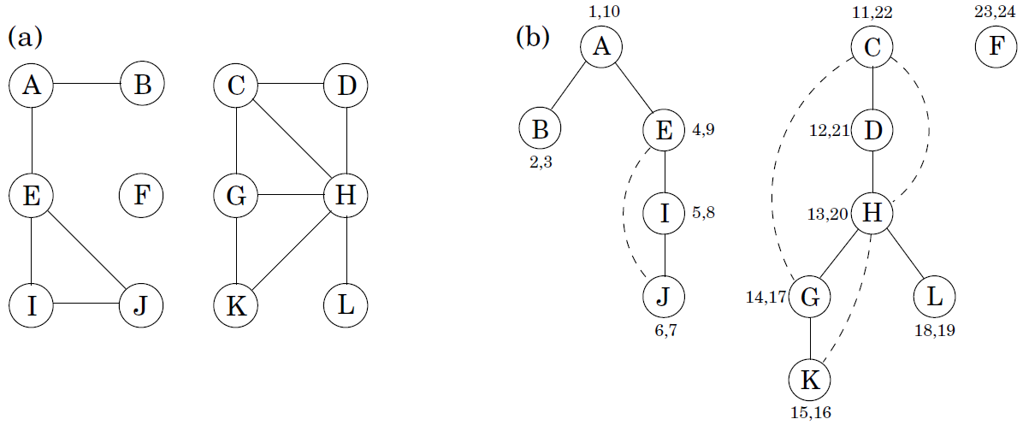
Depth-First Search in undirected graphs
for each node, note down the times of first discovery and final departure.
procedure dfs(G)
for all v∈V
visited(v) = false
for all v∈V
if not visited(v) explore(v)
procedure explore(G, v)
Input: G=(V, E); v∈V
Output: visited(u) = true for all nodes
u reachable from v
visited(v) = true
previsit(v)
for each edge (v, u)∈E
if not visited(u) explore(u)
postvisit(v)
procedure previsit(v)
pre[v] = clock
clock ++
procedure postvisit(v)
post[v] = clock
clock ++

Slide 8
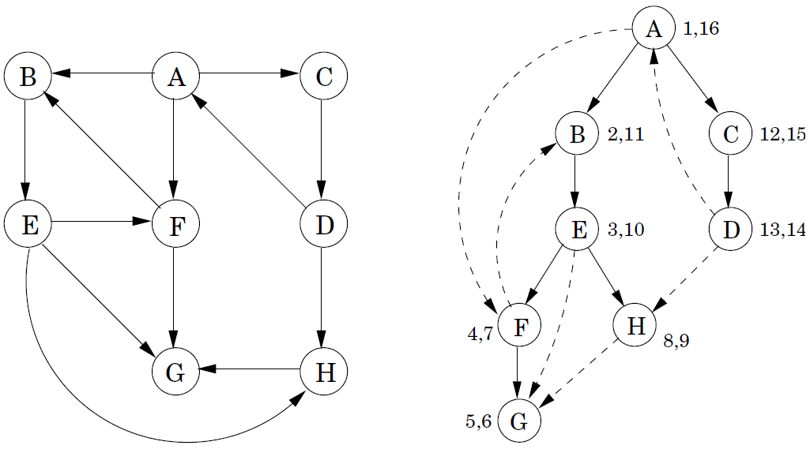
Depth-First Search in directed graphs
DFS run verbatim on directed graphs.
Tree edges are actually part of the DFS forest.
Forward edges lead from a node to a nonchild descendant in the DFS tree.
Back edges lead to an ancestor in the DFS tree.
Cross edges lead to neither descendant nor ancestor; they lead to a node that has already been completely explored (that is, already postvisited).
Notes:
对于一条有向边(u,v)，站在u点看向v。若v尚未访问，则(u,v)被收入搜索树内，成为树边。若v已经被访问过，则有3种可能性。
(1). v是u的非儿子后代。(u,v)为前向边。对v的访问已经发生。经过的是从u到v的其它路径。
(2). v是u的祖先。(u,v)为回边。
(3). v不是u的祖先，也不是u的非儿子后代。v不是u的祖先，表明v的访问已经结束。

Slide 9
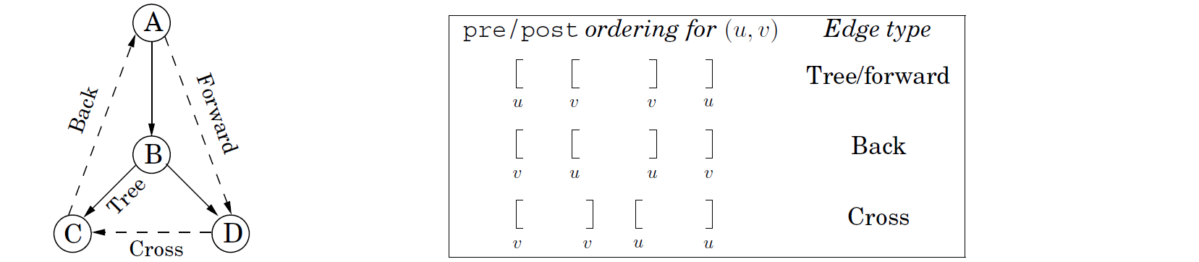
Depth-First Search in directed graphs
DFS run verbatim on directed graphs.
Notes:
对于一条有向边(u,v)，站在u点看向v。若v尚未访问，则(u,v)被收入搜索树内，成为树边。若v已经被访问过，则有3种可能性。
(1). v是u的非儿子后代。(u,v)为前向边。对v的访问已经发生。经过的是从u到v的其它路径。
(2). v是u的祖先。(u,v)为回边。
(3). v不是u的祖先，也不是u的非儿子后代。v不是u的祖先，表明v的访问已经结束。

Slide 10
Directed acyclic graph’s property
Property 1. A directed graph has a cycle iff DFS reveals a back edge.
Proof. if (u, v) is a back edge, then (u, v) and the path from v to u in the search tree consist a cycle.
Conversely, if the graph has a cycle v₀→v₁ → ∙∙∙→ v_{k} → v₀, look at the first node (the lowest pre number) on this cycle to be discovered. Suppose it is v_{i}. All the other v_{j} on the cycle are reachable from it and will therefore be its descendants in the search tree. In particular, the edge v_{i-1}→v_{i} leads from a node to its ancestor and is thus a back edge.
Property 2. In a dag, each edge leads to a vertex with a lower post number.
The only edges (u, v) for which post(u)<post(v) are back edges. So each dag can be topologically sorted, in order of DFS post numbers.
Property 3. Every dag has at least one source and at least one sink.
A vertex with a highest post number, must be a source.
A vertex with a lowest post number, must be a sink.

Slide 11
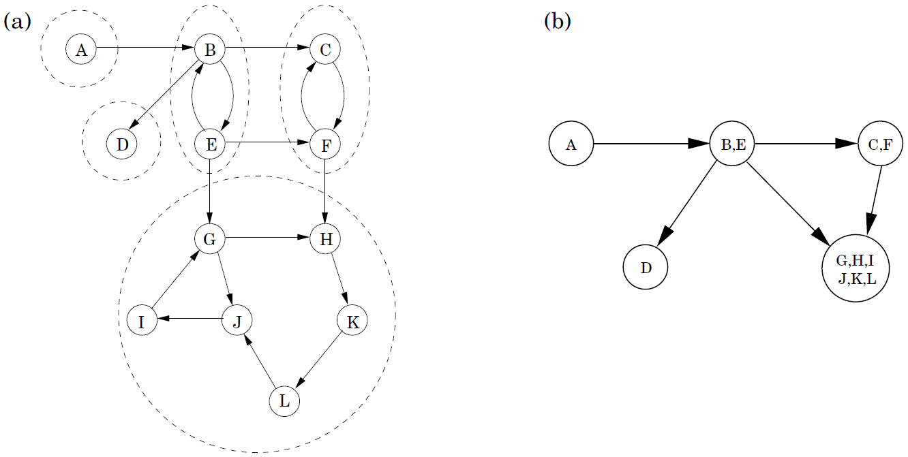
Strongly connected components
Strongly connected components:
Every directed graph is a dag of its strongly connected components.
Source strongly connected component
Sink strongly connected component

Slide 12
An algorithm for strongly connected components
Property 1. If explore() is started at node u, then it will terminate precisely when all nodes reachable from u have been visited.
If we call explore() on a node in a sink strongly connected component, then we will retrieve exactly that component.
Finding a node in a sink strongly connected component is hard. But we can get a node in a source strongly connected component.
Property 2. The node that receives the highest post number in DFS must lie in a source strongly connected component.
This follows from the following more general property 3.
A source strongly connected component of the reverse graph G^{R}, is a sink strongly connected component of G.

Slide 13
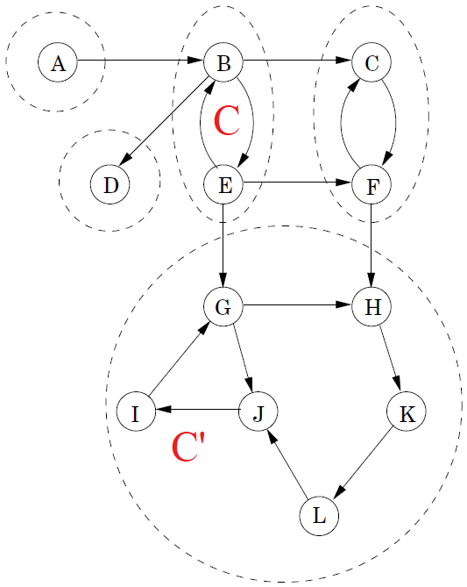
An algorithm for strongly connected components
Property 3. If C and C′ are strongly connected components, and there is an edge from a node in C to a node in C′, then the highest post number in C is bigger than the highest post number in C′.
the strongly connected components can be linearized by arranging them in decreasing order of their highest post numbers.
Proof. (1) If DFS visits C before C′, then all of C and C′ will be traversed before the procedure gets stuck. Therefore the first node visited in C has a higher post number than any node of C′.
(2) if C′ gets visited first, DFS will get stuck after seeing all of C′ but before seeing any of C, in which case the property follows immediately.

Slide 14
An algorithm for strongly connected components
procedure SCC(G)
Input: A digraph G
Output: all strongly connected components of G
1. Run DFS on G^{R}.
2. vertices enter a priority queue Q in descending order of post values
3. while Q is not empty
4. v = Q.pop
5. explore(v)
6. retrive all nodes just explored from Q, output them as a component
How does one construct an adjacency list representation of G^{R} in linear time?
How, in linear time, does one order the vertices of G by decreasing post values?

